Slide 1




G.H. RAISONI COLLEGE OF ENGINEERING
AND MANAGEMENT, WAGHOLI, PUNE.
Department of AI & AIML
AI-Powered Blogging Platform
Guide:
PRO. PRANITA MOHKAL
Name of Projectees
BHAGYASHRI RAJENDRA BAGUL (63)
PIYUSH ATUL BADJATE (64)
SANSKRUTI SURESH CHANDERE (66)
MAHEK ARA MAJID BANGI (70)

Slide 2
Contents
Introduction
Justifications for Selecting the Title
Problem Statement
Literature Survey
Requirements and Model Used
Working
Block Diagram
Expected Result
References

Slide 3
Introduction
In a fast-evolving digital landscape, content creation and consumption are at the forefront of human interaction. Blogging, as a popular medium of sharing thoughts, stories, and expertise, has continuously evolved. Now, imagine a platform where creativity meets cutting-edge technology, giving rise to a new era of blogging—welcome to AI-Powered Blogging Platform
AI-Powered Blogging Platform is not just a blogging platform; it's an AI-powered, immersive environment that harnesses the capabilities of artificial intelligence to enrich the content creation journey. With a seamless blend of user-friendly interfaces and intelligent algorithms, AI-Powered Blogging Platform revolutionizes how blogs are written, curated, and experienced.

Slide 4
Justification For Selecting The Title
Innovation and Tech Integration:
The project involves integrating cutting-edge AI technology into blogging, showcasing innovation.
Relevance and Demand:
Blogging remains significant, and AI infusion enhances user experience, meeting market demand.
Content Quality and Engagement:
AI enhances content quality by providing language, style, and structure suggestions, improving engagement.
Personalization and User Experience:
AI allows personalized user experiences by tailoring content recommendations based on behavior, enhancing satisfaction.
Learning Opportunities:
Building this platform offers a learning experience in AI, NLP, web development, and design—valuable skills in the job market.
Competitive Advantage:
The AI integration positions the platform as innovative and competitive, attracting users and collaborators.

Slide 5
Problem Statement
Existing blogging platforms fall short in providing AI-powered real-time content refinement suggestions, hindering content quality improvement. Additionally, they lack personalized user experiences and interactive AI features, limiting reader engagement. Bridging this gap, our project aims to create an AI-Powered Blogging Platform that enhances content creation, enriches user interactions, and offers an innovative approach to blogging with AI-driven advancements.

Slide 6
Literature Survey
Sr. No. | Paper Title and its Author | Details of Publication | Findings
1 | Improving Blog Engagement Using Natural Language Processing" Authors: Johnson, A., et al. | Proceedings of the ACL, 2018 | Johnson et al. explore using natural language processing to enhance engagement on blogs by analyzing content and user behavior for a personalized experience, aiming to make blogs more interactive and appealing.
2 | Next.js: A Comprehensive Overview Authors: Williams, K., et al. | Journal of Web Development, 2019 | Next.js is a popular JavaScript framework for building web applications, offering server-side rendering, routing, and optimized performance. It simplifies the development process by enabling efficient React-based application creation.

Slide 7
Requirements & Modules Used
1.Web Development Frameworks:
Next.js
2.Frontend Technologies:
React
Tailwind CSS:
3.Backend Technologies:
Node.js
Express.js
4.Database Technologies:
MongoDB or PostgreSQL
5.AI and Natural Language Processing (NLP):
OpenAI GPT (Generative Pre-trained Transformer)

Slide 8
Working
Write & Refine: Start your writing journey in the intelligent content editor. As you draft your article, AI algorithms analyze your content and provide real-time suggestions for improvement.
AI Enhancements: Accept AI-generated recommendations to refine language, style, and structure. Leverage AI's capabilities to make your content shine.
Publish & Engage: Publish your enhanced article to a global audience. AI-powered recommendations ensure your blog reaches the right readers, enhancing engagement and impact.
Join AI-Powered Blogging and Redefine Blogging
Join us at AI-Powered Blogging and be part of a community where creativity is supercharged by artificial intelligence. Experience a new standard of content creation, reader engagement, and overall blogging excellence. Let's redefine the art of blogging, one AI-powered post at a time.

Slide 9
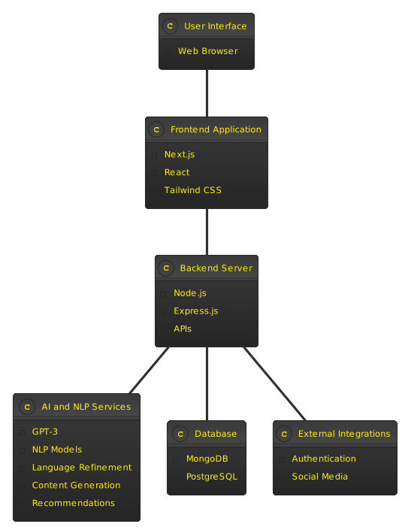
Block Diagram

Slide 10
Expected Result
Intuitive Interface: Users will benefit from a user-friendly and intuitive interface, making it easier to create and consume content.
Effortless Interaction: Smooth and interactive features, aided by AI, will streamline user interaction, ensuring a seamless and enjoyable experience.
Content Quality Improvement: The integration of AI will substantially enhance the overall quality and coherence of the blog posts.
Time Efficiency: AI's assistance in content generation and refinement will speed up the content creation process, allowing bloggers to produce more articles in less time.
Overall, this project aims to change how people write and read blogs, using AI to make it better. The platform is expected to be unique, bringing in more users and offering an exciting and improved blogging experience.

Slide 11
References
GPT-3 Documentation: Link: OpenAI GPT-3 Documentation
Next.js Documentation: Link: Next.js Documentation
React Documentation: Link: React Documentation
Tailwind CSS Documentation: Link: Tailwind CSS Documentation
Node.js Documentation: Link: Node.js Documentation
MongoDB Documentation: Link: MongoDB Documentation

Slide 12
Thank you !

